Slide 1

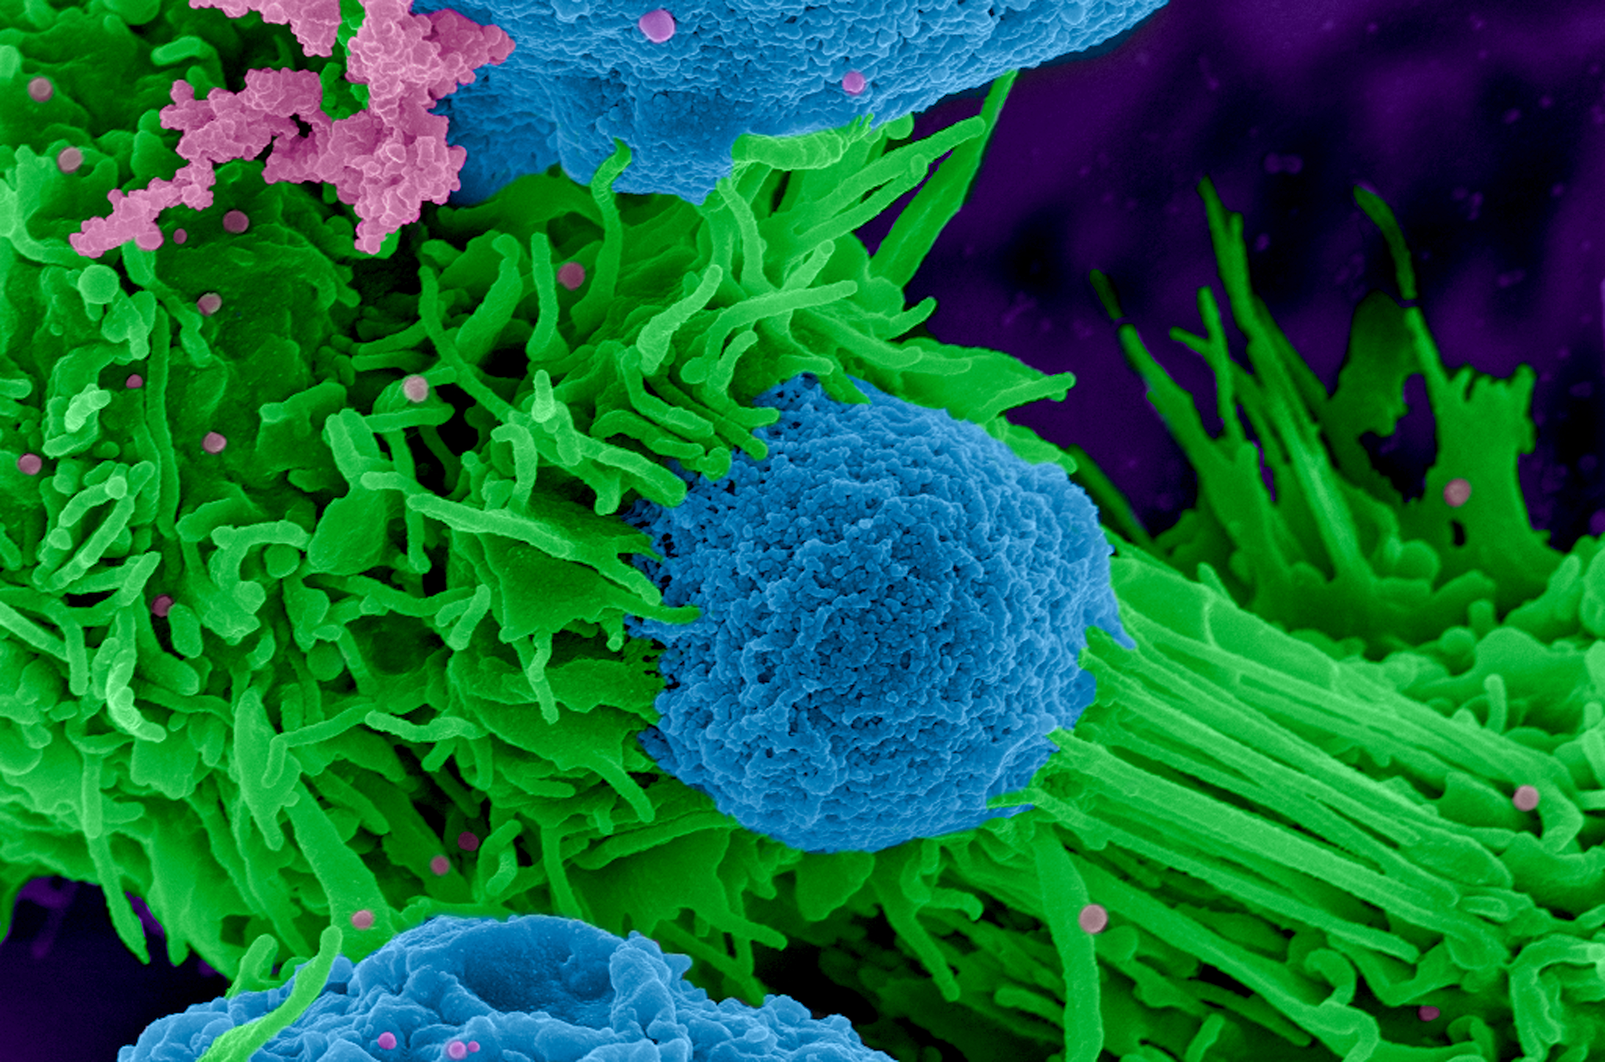

Slide 2
Audience & Tone

Slide 3
Website Inspirations

Slide 4
Design Elements I’m Most Proud of

Slide 5
Development Processes I Overcame

Slide 6
Page Development Struggles

Slide 7
Mid-Term Project Lessons

